Slide 1
Agentic AI Engineering
Advanced Multi-Vector RAG Embedding Strategies
with
ChromaDB
Max Montaseri

Slide 2
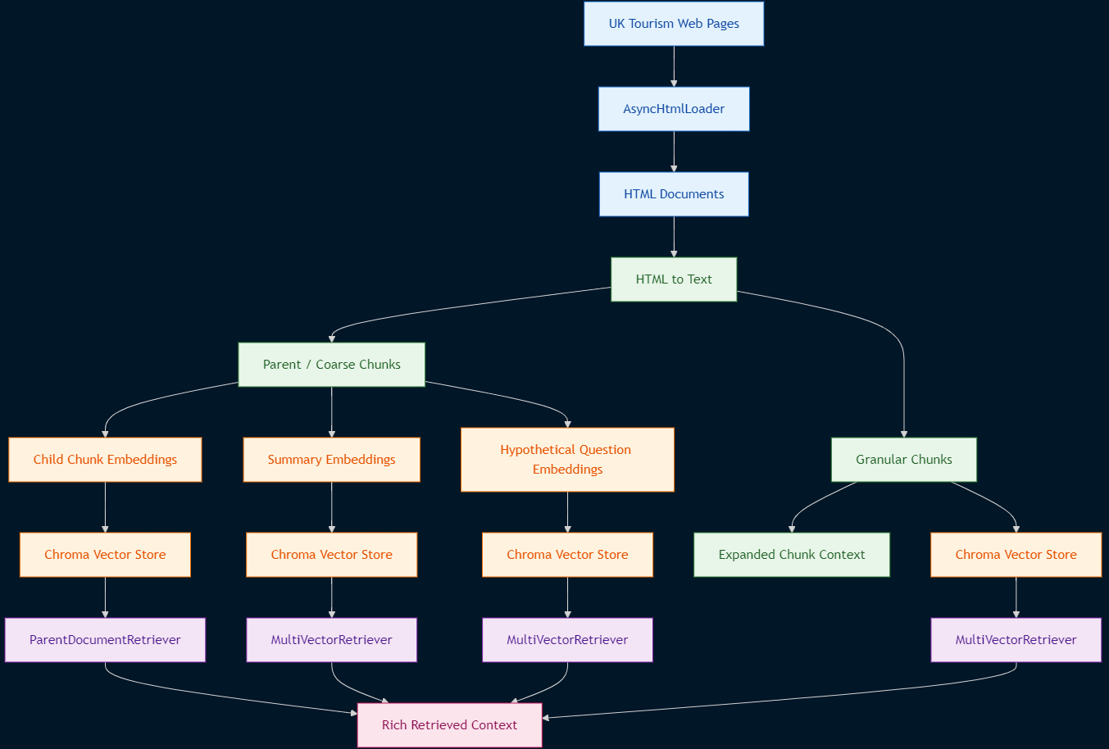
Architecture

Slide 3
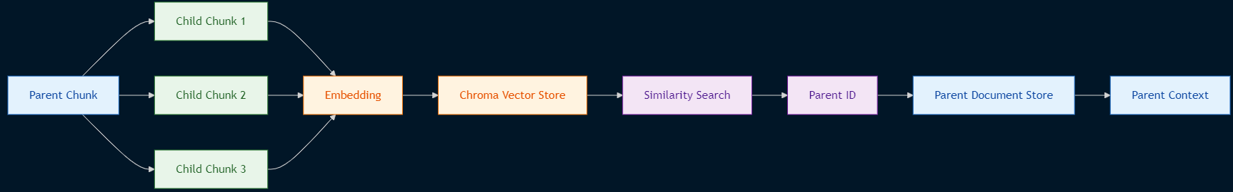
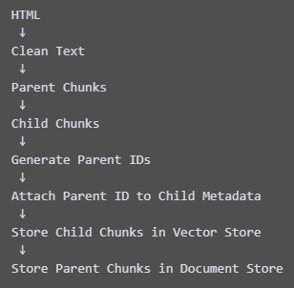
ParentDocumentRetriever Strategy
Data architecture
MultiVectorRetriever with Child Chunks Strategy
Ingestion flow

Slide 4
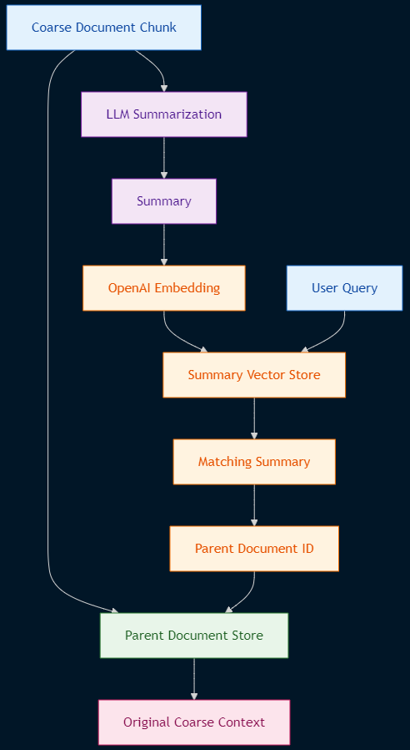
Summary Embeddings
Strategy

Slide 5
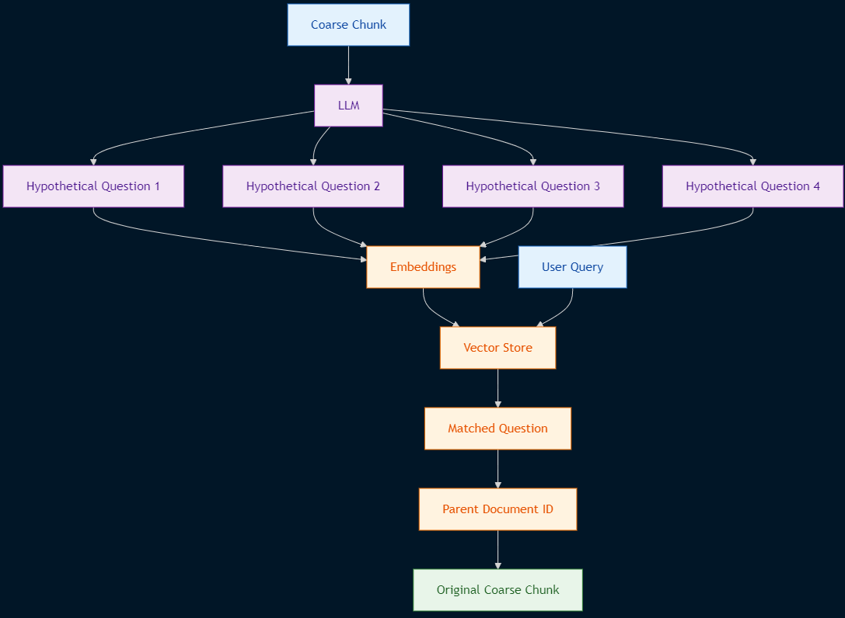
Hypothetical Question
Embeddings Strategy

Slide 6
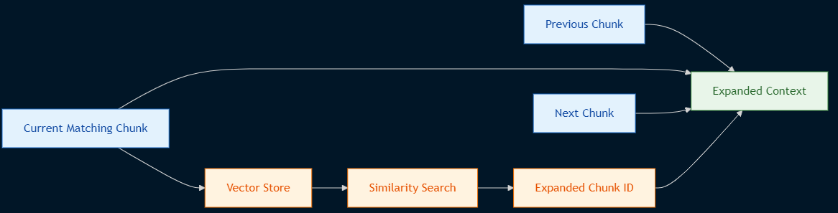
Granular Chunk Expansion Strategy

Slide 7
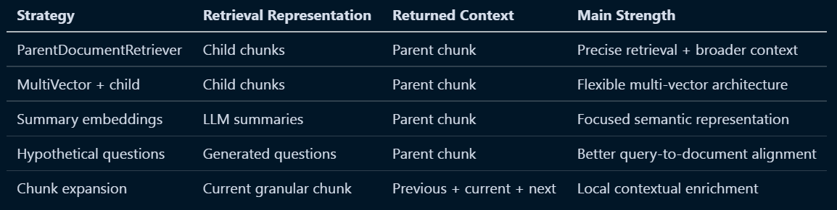
Strategy Comparison

Slide 8
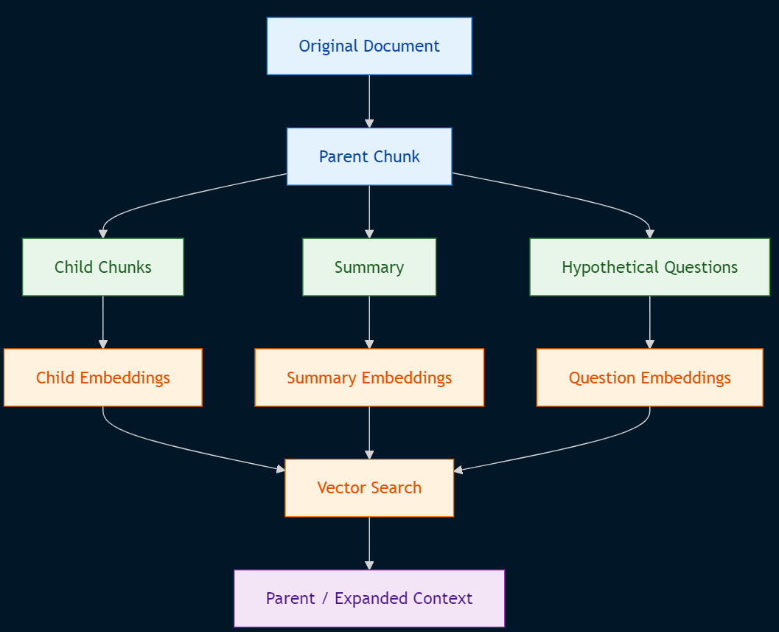
Conceptual Comparison

Slide 9
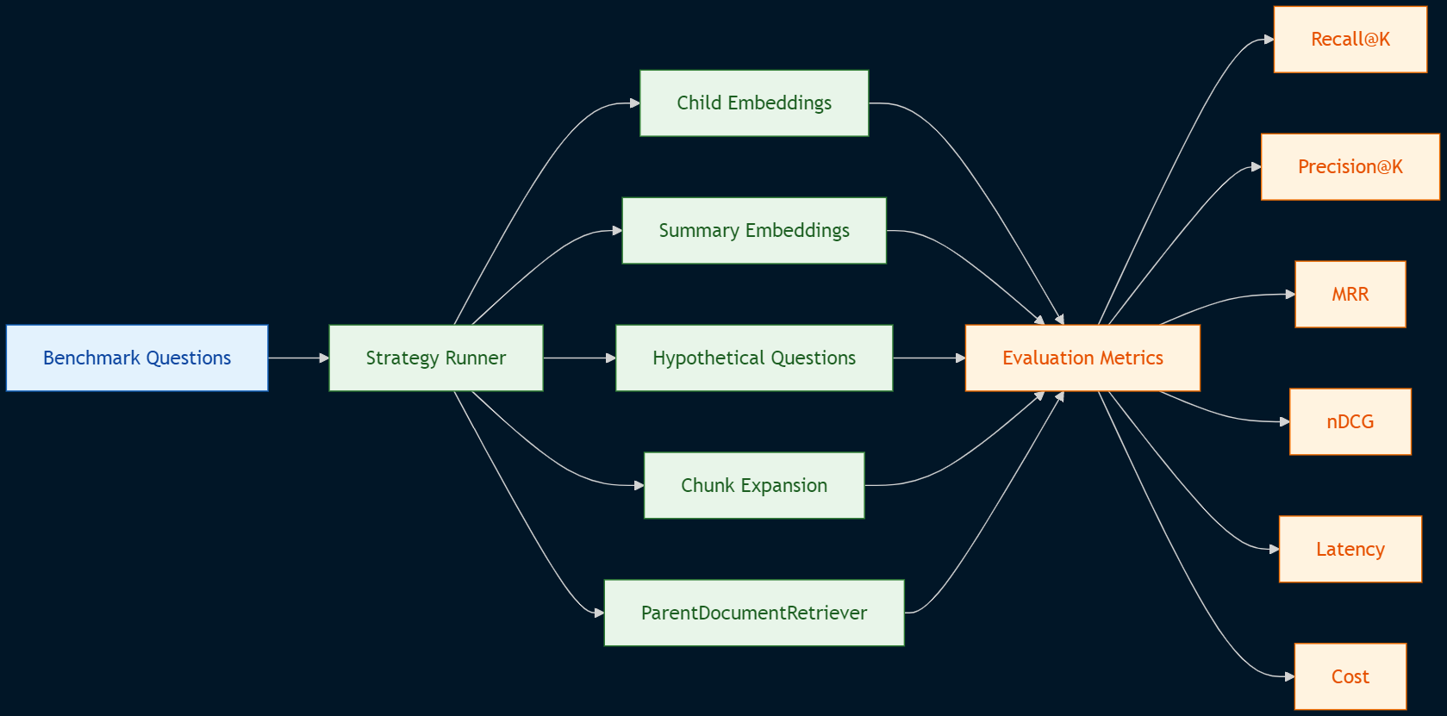
Recommended Evaluation Architecture

Slide 10
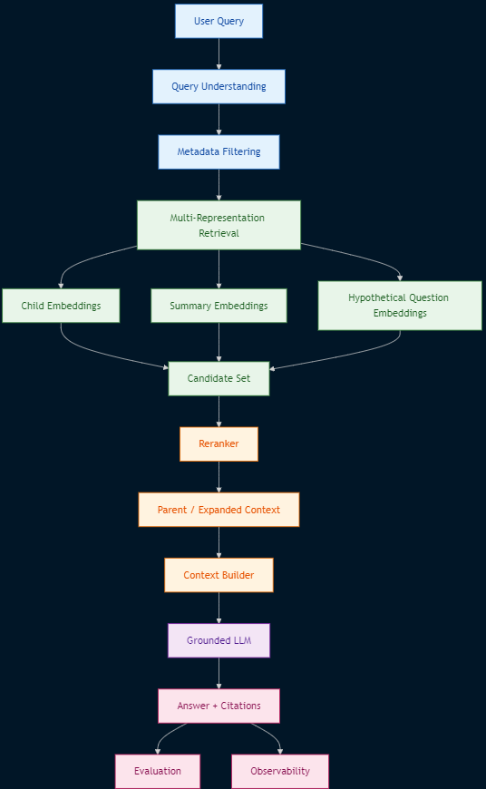
Enterprise RAG Architecture

